Slide 1
Understanding Standard Deviation
-Pooja Preethi Mugan M

Slide 2
CONTENTS
Introduction to Standard Deviation
Calculating the Standard Deviation
Example Calculation
Standard Deviation VS Mean
Practical Uses
Summary

Slide 3
What is Standard Deviation?
A measure of the dispersion or spread of data points around the mean.
Indicates the variability within a dataset.

Slide 4
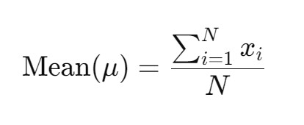
Calculating the Mean
Step 1: Compute the Mean (Average)
Sum of all data points divided by the number of data points.

Slide 5
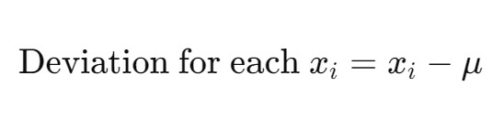
Calculating Deviations
Step 2: Calculate Deviations
Difference between each data point and the mean.

Slide 6

Squaring the Deviations
Step 3: Square Each Deviation
Ensures all values are positive and gives more weight to larger differences.

Slide 7
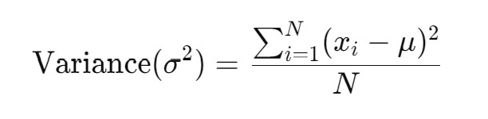
Finding the Variance
Step 4: Compute the Variance
Average of the squared deviations.

Slide 8
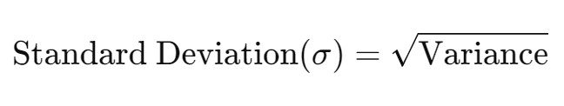
Calculating Standard Deviation
Step 5: Standard Deviation
Square root of the variance.

Slide 9
Example Calculation
Data Points | Mean | Deviations | Squared Deviations | Variance | Standard Deviation
4 | 5.2 | -1.2 | 1.44 | 2.96 | 1.720465053
8 | 5.2 | 2.8 | 7.84 | 2.96 | 1.720465053
6 | 5.2 | 0.8 | 0.64 | 2.96 | 1.720465053
5 | 5.2 | -0.2 | 0.04 | 2.96 | 1.720465053
3 | 5.2 | -2.2 | 4.84 | 2.96 | 1.720465053

Slide 10
Standard Deviation vs. Mean
Standard Deviation Less Than the Mean
Standard Deviation Greater Than the Mean
Consistency
Low Spread
Predictability
Inconsistency
High Spread
Unpredictability

Slide 11
Practical Uses
Why is Standard Deviation Useful?
Comparing Datasets: Understand differences in variability.
Risk Assessment: Measure investment risk.
Quality Control: Monitor product consistency.
Understanding Distribution: Analyze data spread in normal distributions.

Slide 12
SUMMARY
Standard deviation measures data spread around the mean.
Provides insights into the variability of a dataset.
Essential tool in statistics for analysis and decision-making.

Slide 13
THANK YOU
-Pooja Preethi Mugan M​
mppm167@gmail.com

